Slide 1

Customer Segmentation Based On Their Credit Card Usage Behavior
Pari Manouchehri
March 2017

Slide 2
Project Outline
Introduction
Objective
EDA
Cleaning Dataset
Analyze Features
Feature Engineering
Applying Dimensional Reduction
Clustering Methods
Kmeans Clustering
Hierarchical Clustering
Clustering with Gaussian Mixture Models (GMM)
Conclusion
Future Work
Density-Based Spatial Clustering of Applications with Noise (DBSCAN)

Slide 3
Introduction:
The dataset used for this analysis was taken from Kaggle dataset.
Dataset contains credit card usage of customers with 18 behavioral features.
Segmentation of customers can be used to define marketing strategies.
Dataset summarizes usage behavior of about 9000 active credit card holders during the last 6 months, updated 2 years ago.
Customer segments help us understand the patterns that distinguish customers.
Objective:
Customer Segmentation by using Customer Behaviors in order to Define a Proper Marketing Strategy.

Slide 4
Exploratory Data Analysis (EDA)

Slide 5
Data Cleaning Summary
Filling Missing Values
1
Removing Outlier By Zscore
2
Preparing Dataset Using Standardize
3

Slide 6
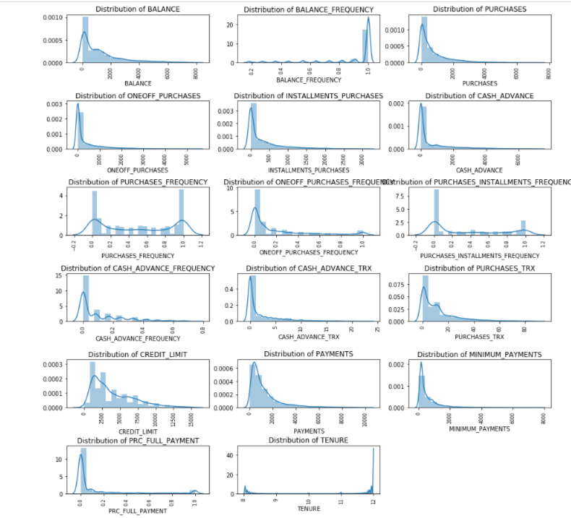
Distribution of Features

Slide 7
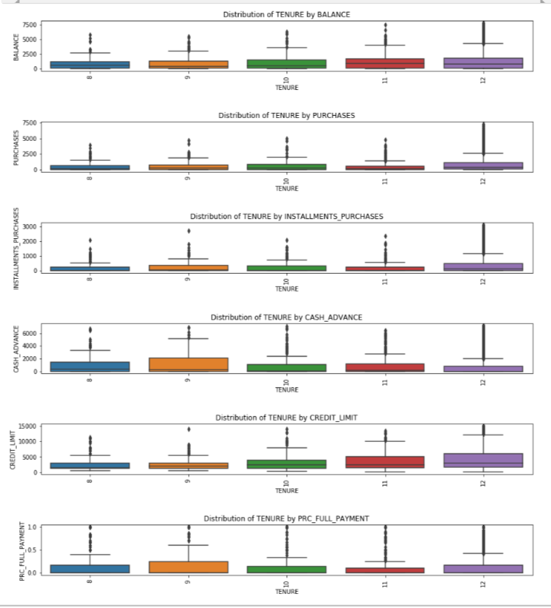
Distribution of TENURE by some Features

Slide 8

FEATURE ENGINEERING

Slide 9
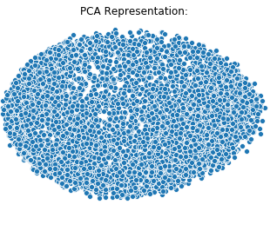
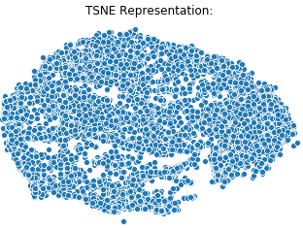
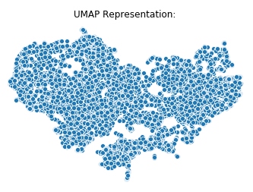
Visualizing Using Dimensionality Reduction
Applying Dimensionality Reduction:
Principal Components Analysis (PCA)
t-Distributed Stochastic Neighbor Embedding (t-SNE)
Uniform Manifold Approximation and Projection (UMAP)

Slide 10
Dimensional Reduction Results:
The percentage of total variance in the dataset explained by each component from PCA is around 0.47.
In PCA, time elapsed is much less than TSNE and UMAP. Also UMAP time elapsed is much less than TSNE.
In UMAP we can identify classes quite well in contrast to TSNE and PCA representations.

Slide 11
Clustering Methods

Slide 12
Kmeans Clustering

Slide 13
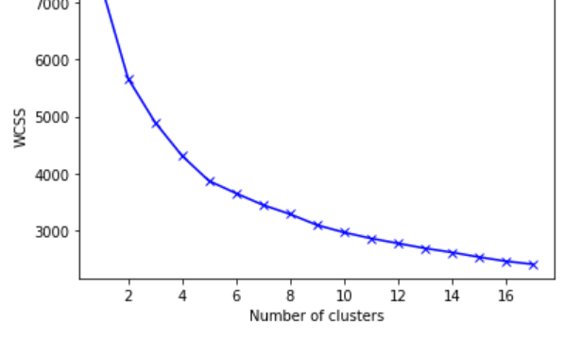
Elbow Method:
Finding the Best Number of Clusters with Elbow Method:

Slide 14
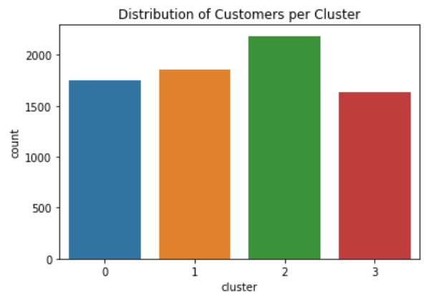
Distribution of Customers Per Cluster

Slide 15
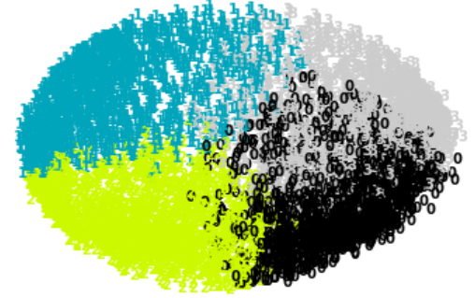
Plot Kmeans With 4 Clusters Using PCA

Slide 16
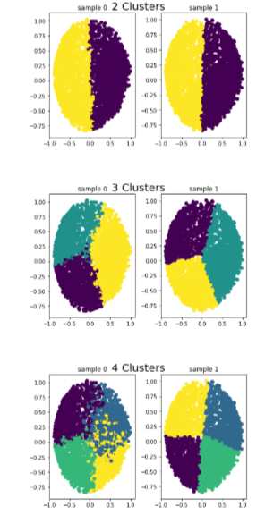
Observe Consistency across Sub-samples of Kmeans Clustering

Slide 17
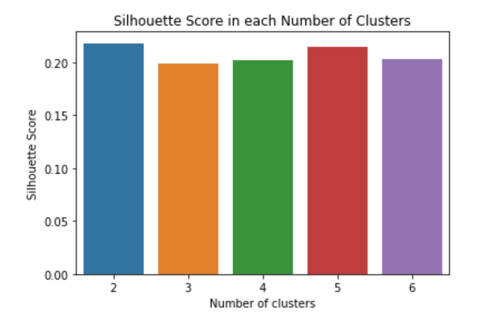
Finding Best Number Of Clusters By Calculating Silhouette Score
The best solution is for the 2 clusters as its silhouette score is the highest.

Slide 18
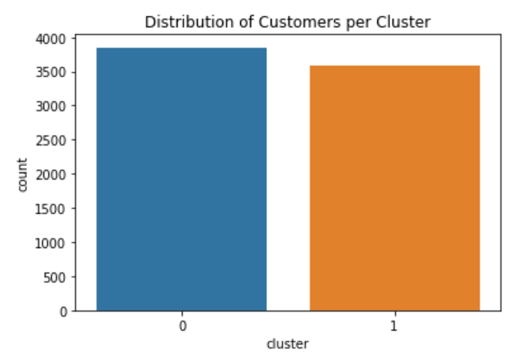
Kmeans Clustering with High Silhouette Score

Slide 19

Hierarchical Clustering

Slide 20
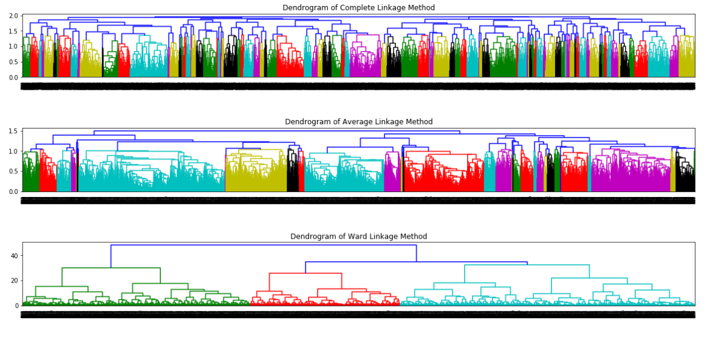
Sketch The Dendrogram Using The Different Linkage Method

Slide 21
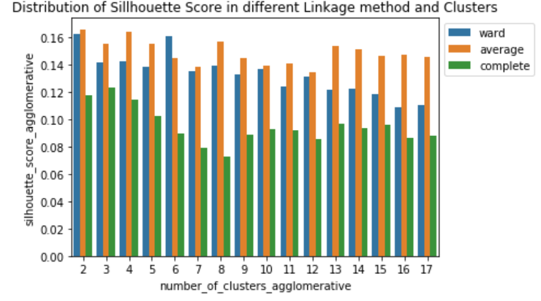
Finding Best Number Of Clusters By Calculating Silhouette Score
The highest number of silhouette score is for number of clusters 2 with Average linkage method.
Based on the dendogram, the Ward linkage has better distribution, so we selected the Ward one with 2 clusters.

Slide 22
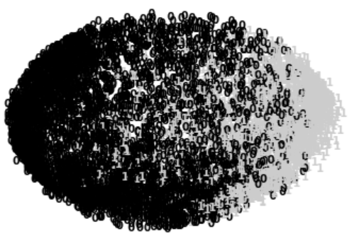
Plot Hierarchical with 2 Clusters Using PCA

Slide 23
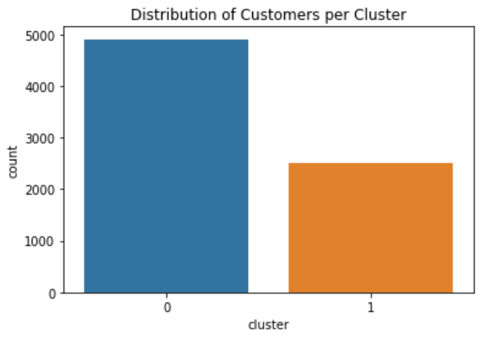
Hierarchical Clustering with High Silhouette Score

Slide 24
Density-Based Spatial Clustering of Applications with Noise (DBSCAN)

Slide 25
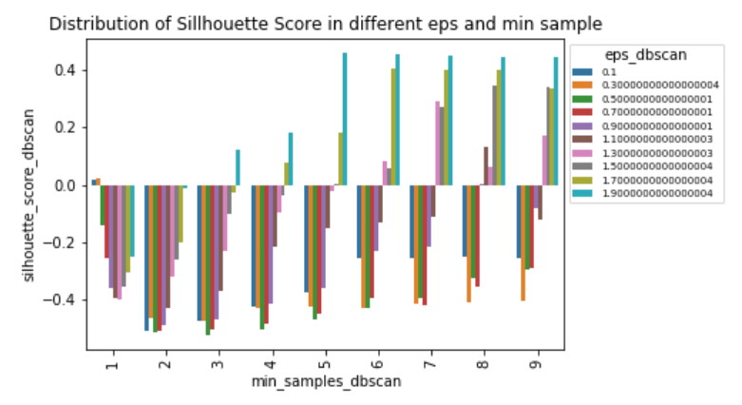
Finding Best Number Of Clusters By Calculating Silhouette Score
The highest number of silhouette score is for 5 min_ sample and eps:1.9 with 2 clusters

Slide 26

Plot DBSCAN with 2 Clusters by PCA
Result does not seem to be a suitable method because all number of customers fall into one cluster and distribution of variables is not homogenous.

Slide 27
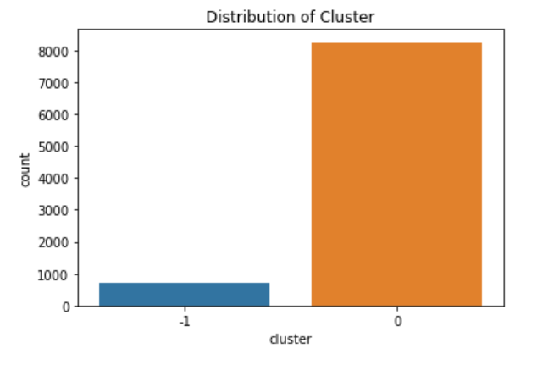
DBSCAN Clustering with High Silhouette Score

Slide 28
Clustering with Gaussian Mixture Models (GMM)

Slide 29
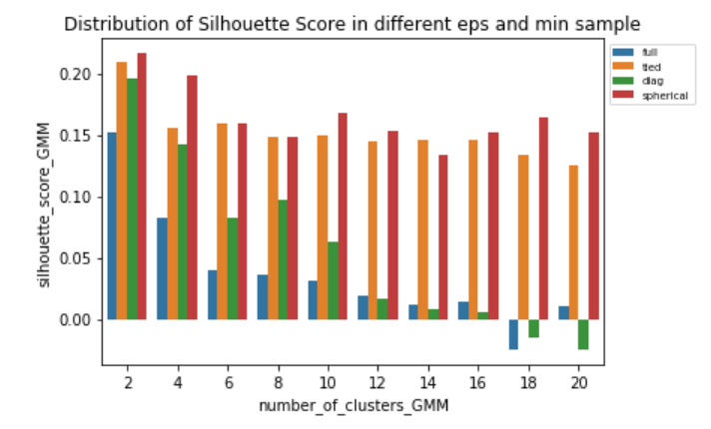
Finding best number of Clusters by Calculating Silhouette Score
The highest Silhouette Score is for number of 2 clusters and covariance_type of Spherical.

Slide 30
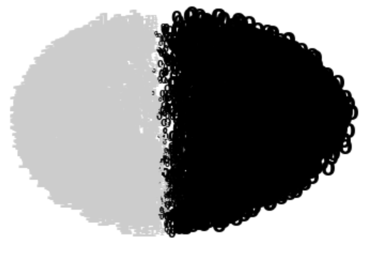
Plot GMM With 2 Clusters By PCA With Size-based Probability

Slide 31
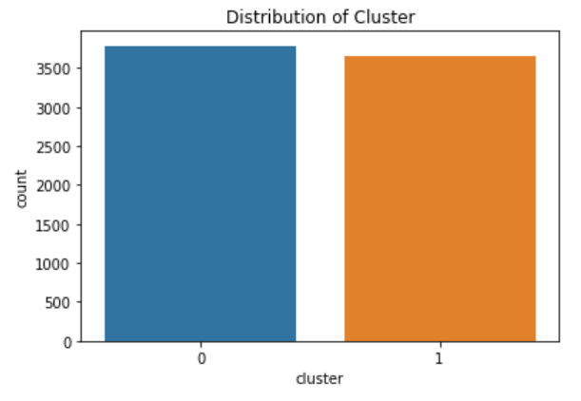
GMM Clustering with High Silhouette Score

Slide 32
Comparing Results of Methods

Slide 33
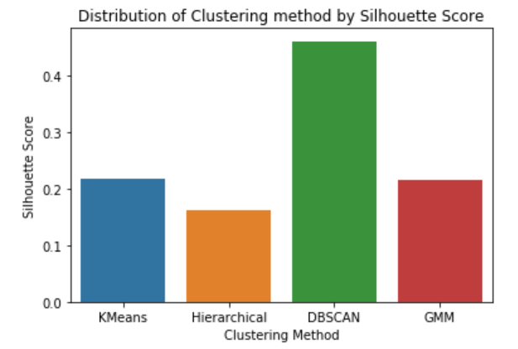
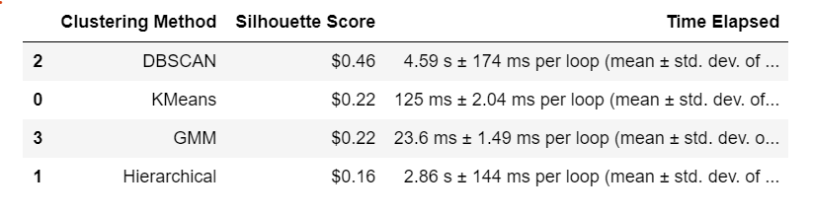
Compering Results of Methods to Find the Optimal Number of Cluster Model

Slide 34
Results of Comparing Methods
Evaluating model with the highest silhouette score metric to choose the best method does not seem suitable for DBSCAN model even with a high score.
This is because most of the customers clustered in the one cluster and the lower number of variables are as an outlier, so density is very much in the first cluster.
The Second Highest Silhouette Score is for Kmeans and GMM.

Slide 35
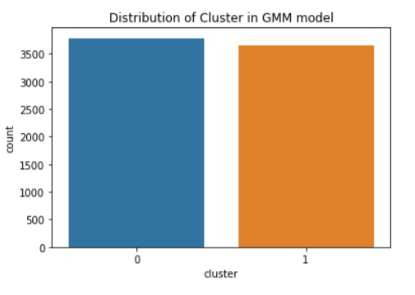
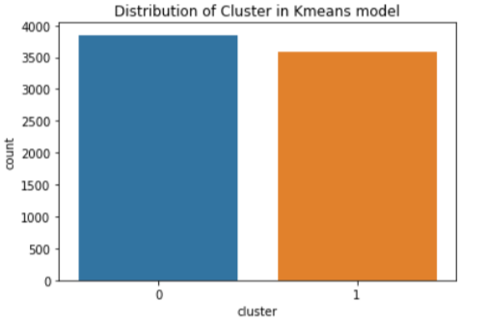
Comparing Kmeans And GMM Clustering Method In Terms Of Customer Distribution Per Cluster:
Kmeans:
GMM:

Slide 36
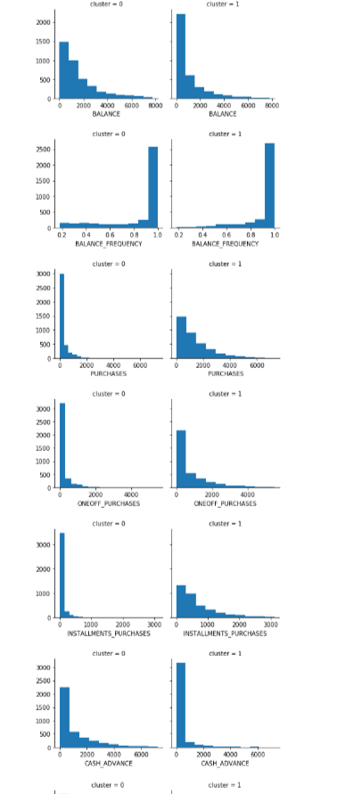
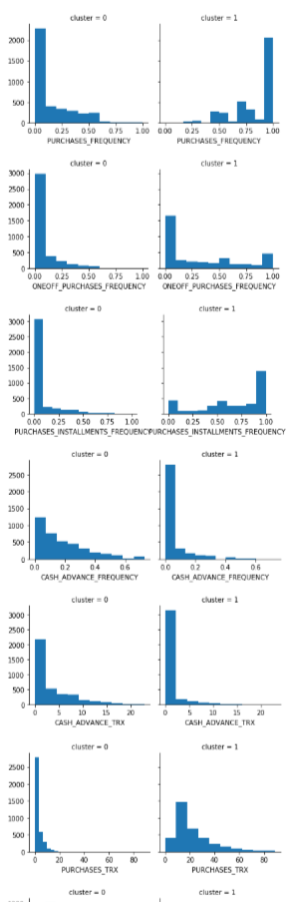
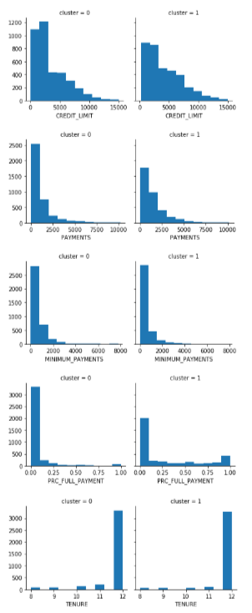
Kmeans Clustering Interpretation

Slide 37
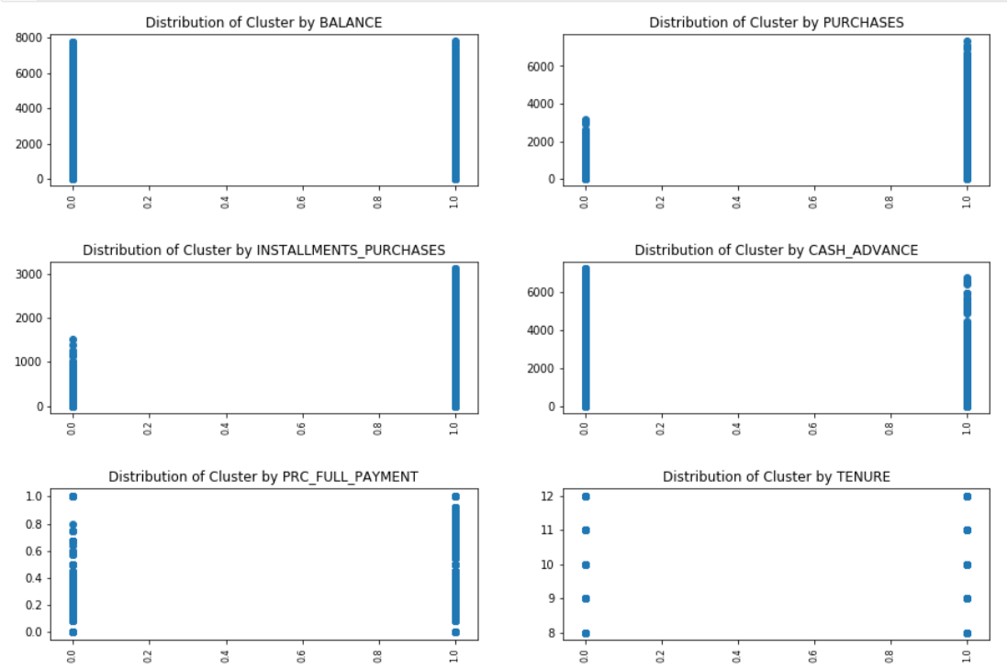
Distribution of Kmeans Cluster by some Features

Slide 38

Kmeans Clustering Results:
Based on the results:
Cluster 0: Indicates a group of customers who have a higher BALANCE and CASH_ADVANCE with low PURCHASES and PURCHASES_FREQUENCY. These customers have the least credit card usage and their number is slightly higher than the other cluster.
Cluster 1: Indicates a group of customers who have high PURCHASES and PURCHASES_FREQUENCY. These customers have more credit card usage and make more frequent purchases.

Slide 39
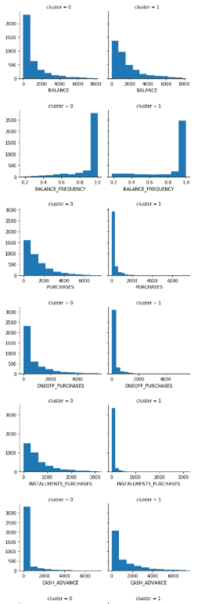
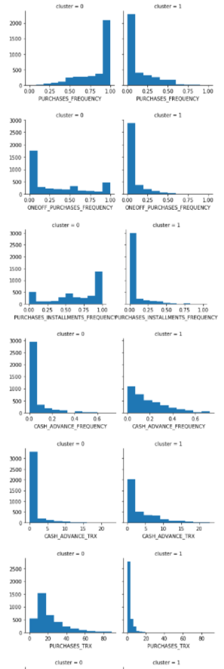
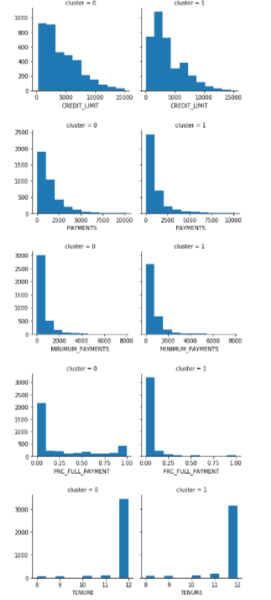
GMM Clustering Interpretation

Slide 40
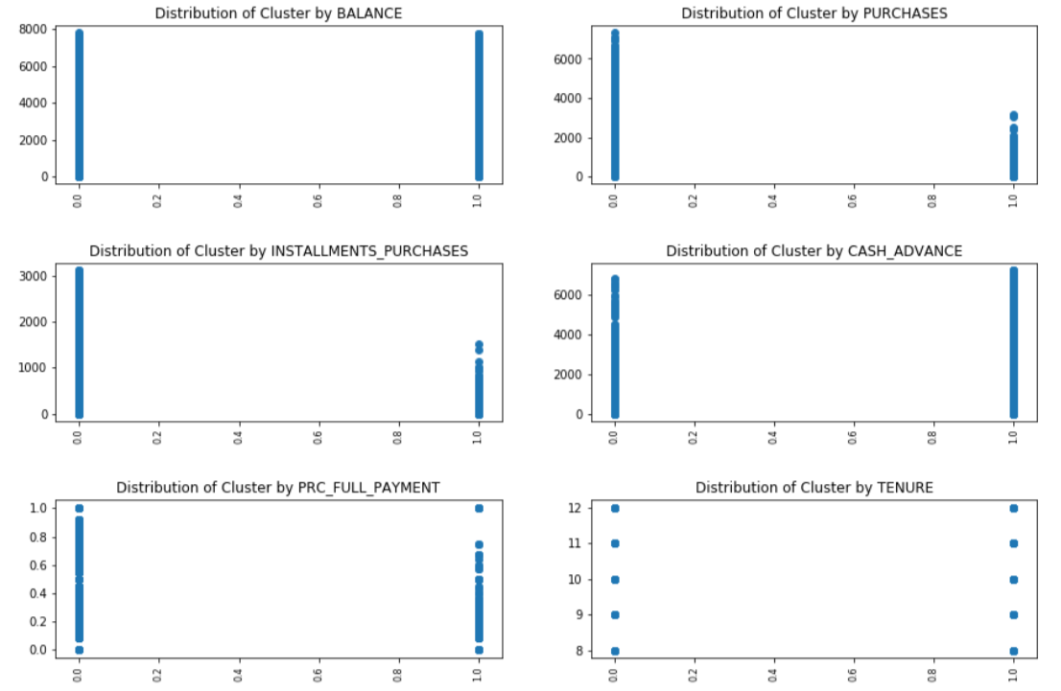
Distribution of GMM Cluster by some Features

Slide 41

GMM Clustering Result:
Cluster 0: Indicates a group of customers who have a low BALANCE and CASH_ADVANCE with high CREDIT_LIMIT, PURCHASES. These customers have high credit card usage. The number of customers in this cluster is slightly higher.
Cluster 1: Indicates a group of customers who have a high BALANCE and CASH_ADVANCE with low PURCHASES and PURCHASES_FREQUENCY. These customers have less usage of their credit card and their number lower.

Slide 42
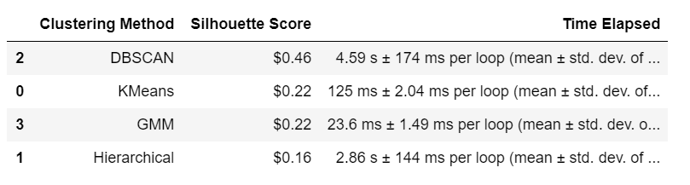
Comparing Kmeans and GMM Clustering method in terms of Time Elapsed
Time Elapsed in GMM method is much less than kmeans method.

Slide 43
Conclusion:
I chose the GMM model in contrast with Kmeans.
The variable distribution is better per cluster without density.
GMM Time Elapsed is much less.
GMM models provide better customer segmentation understanding by using the 2 clusters model:
Cluster 0:
The group of customers with low BALANCE & CASH_ADVANCE with high PURCHASES.
These customers have high credit card usage.
The number of customers in this cluster is slightly higher.
This group can be the target for market research.
Cluster 1:
The group of customers with high BALANCE and CASH_ADVANCE with low PURCHASES.
These customers have the least credit card usage.
The number of customers in this cluster lower.
This group can be assumed for marketing strategies target. Behavior of clustering segmentation of Cluster 0 from marketing research can be used to encourage these customers for higher credit card usage.

Slide 44
Future Works
Applying these models without removing outlier and comparing the result with this.
Quality of the dataset could have been improved as well, for example dataset including Age, Income, Sex, etc.
Analysis of the Credit Card usage behavior can be enriched to find the reason of Customers Segmentation.
More data can be added to the analysis to broaden conclusions.
Newer data can be helpful in drawing better conclusions.

